Slide 1


Sanitation for People with Disabilities: A Framework for Research and Practice
Gauri Desai, MPH
Korydon Smith, EdD, MArch
Pavani Ram, MD
James Jensen, PhD
James Lenker, PhD
Jane Wilbur, MSc
Notes:
Change this to the order in the abstract

Slide 2
Outline
Background
Use of Assistive Technologies
Sanitation-for-all Framework

Slide 3

Millennium Development Goals
    MDG # 7, target 10: To halve by 2015, the proportion of people without sustainable access to safe drinking water and basic sanitation
    The sanitation goal has been missed by almost 700 million people
mdg500.org
Notes:
Established in the year 2000

Slide 4
Sanitation in the context of disability
    2.4 billion people lack access to improved sanitation facilities
    Global prevalence of disability estimated at 15.6% (2011)
    80% of these people live in low- and middle-income countries
    ~ 360 million people with disabilities lack access to improved sanitation facilities
    Millions may have been counted as having access, but may not be able to use facilities due to their inoperability

Slide 5


Sanitation for all
The United Nations Sustainable Development Goals
Convention on the Rights of Persons with Disabilities
Notes:
SDGs are post 2015 goals
The United Nations Convention on the Rights of People with Disabilities recognizes the right to improvement of standard of living for people with disabilities
Includes the right to safe water and sanitation

Slide 6
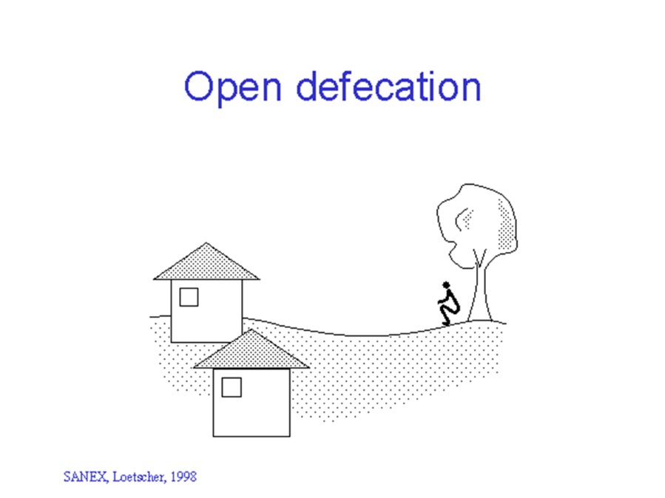

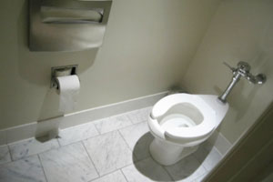
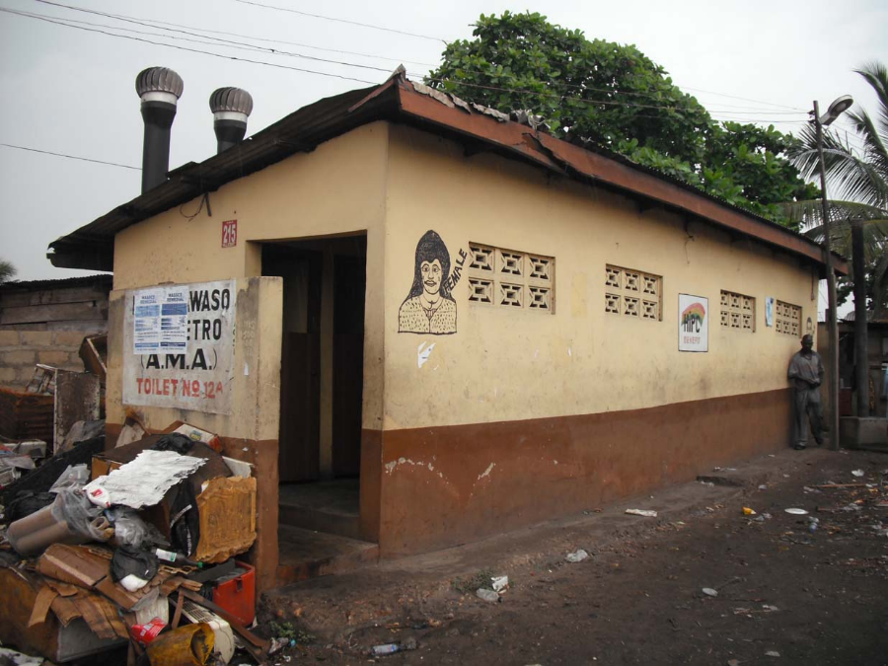
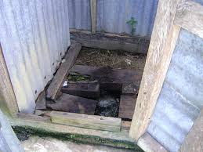
Current Sanitation Ladder – WHO/UNICEF
Equitable sanitation
Improved sanitation facilities: 68%
Shared sanitation facilities: 9%
Unimproved sanitation facilities: 10%
Indianexpress.com
SuSanA Secretariat
SANEX, Loetacher, 1998
environmentalwatchman.blogspot.com
Open defecation: 13%

Slide 7

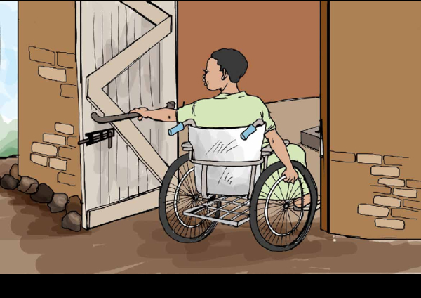

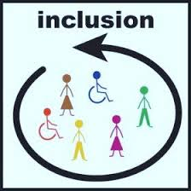
Factors affecting access
Personal: Cognitive, physical, sensory abilities
Environmental:
Design, location
Societal:
Attitudes, beliefs
Institutional:
Inclusive policies
Use of Assistive Technology
Compassionandchoices.org
blog.ncpad.org, avenuescoaching.com

Slide 8
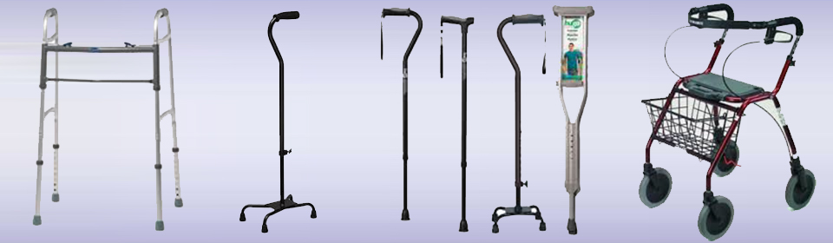
Assistive Technology
Any device, system, or software used to improve or maintain the functioning of individuals with disabilities
eliteorthocare.com
Notes:
ATIA, A. T. I. A. 2016. What is Assistive Technology? [Online]. Chicago, IL, USA. Available: http://www.atia.org/i4a/pages/index.cfm?pageid=3859 2016].

Slide 9
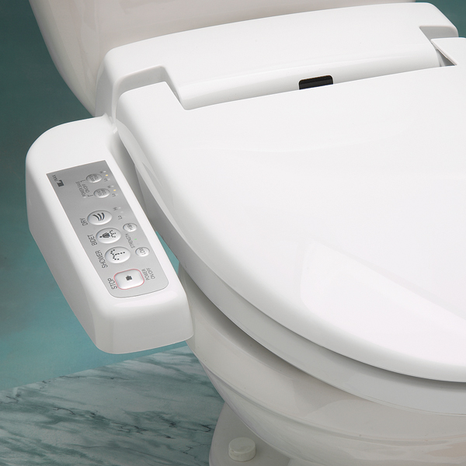
Assistive Technology
Sophisticated devices for high-resource settings, simple devices for low- and middle-income settings
ncmedical.com
Jones and Reed, 2005

Slide 10
Assistive Technology
Heavy reliance on these for sanitation purposes
Individualized solutions, scaling up may be difficult
Use of assistive technologies signals loss of function
Possibly stigmatizing

Slide 11
Factors affecting access
Personal: Cognitive, physical, sensory abilities
Environmental:
Design, location
Societal:
Attitudes, beliefs
Institutional:
Inclusive policies
Assistive Technology does not address all of these
Compassionandchoices.org
blog.ncpad.org, avenuescoaching.com

Slide 12
Sanitation-for-all Framework

Slide 13
Sanitation-for-all Framework: Objectives
To understand the strengths and limitations of utilizing assistive technologies in improving sanitation access
To build upon existing frameworks in order to understand the multiple, dynamic factors involved in providing sanitation for people with disabilities
To expand the WHO and UNICEF’s “sanitation ladder” to include current sanitation-for-all initiatives

Slide 14
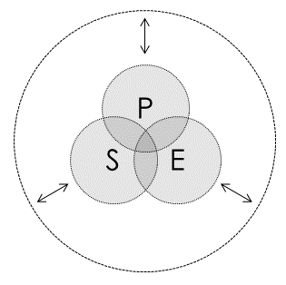
Sanitation-for-all Framework
Three interacting elements directly impact sanitation access—personal attributes (P), societal factors (S), and environmental factors (E)
Institutional structures (represented by the outer circle) have a reciprocal, but moderating, relationship with these elements
The degree to which the central elements (P, S, and E) overlap represents the degree to which equitable sanitation has been achieved
Notes:
For example, if the government or a municipal corporation of an area builds a sanitation facility that is accessible using ramps, so that wheelchair users can access it, and if it is close to the disabled person’s home so that the women from the household can also use it, then we can say that these 3 elements have overlapped. This is because the wheelchair user feels that she can use the facility, it is not against the social norms of seeing women go to the facility, and the design is accessible.

Slide 15
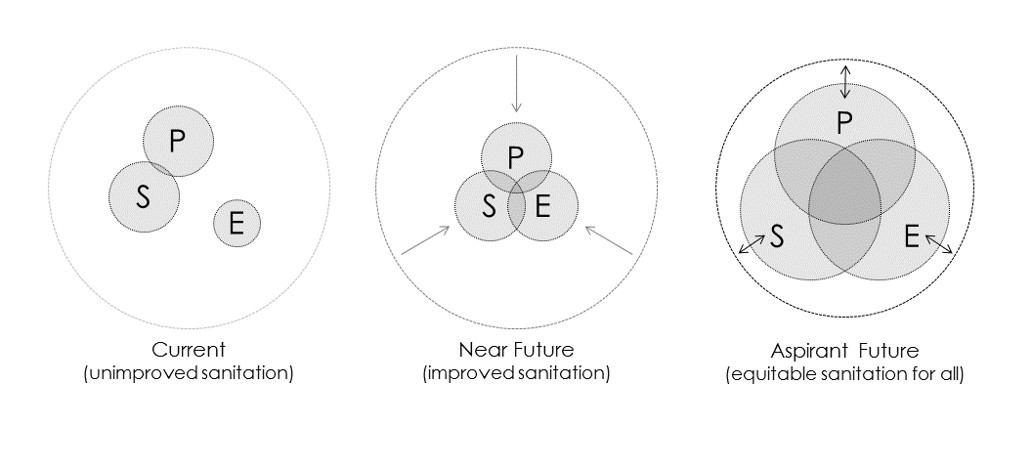
Three Phases of Development
Current
(unimproved sanitation facilities)
Near future
(improved sanitation facilities)
Aspirant future
(equitable sanitation for all)
P – Personal Factors
S – Social Factors
E – Environmental Factors
I – Institutional Structures
Notes:
Change to Personal, social etc. Remove animation.

Slide 16
Current state: Unimproved sanitation facilities
P - Unchanging characteristic of an individual
S – Self reliance/Reliance on caregivers
E – Remain Unmoderated
I - Not equipped
Aleka, Ethiopia
WaterAid/Wegayehu
Notes:
Has to crawl inside the facility
Very little overlap

Slide 17
Near future: Improved sanitation facilities
P – Modifiable characteristic of groups
S – Education, behavior change programs
E – Use of assistive technology
I – Advocacy organizations
Hari Bahadur Sapkota, Nepal
WaterAid/Anita Pradhan
Notes:
WaterAid Nepal installed a latrine chair
Use of ATs
Some overlap

Slide 18
Aspirant future: Equitable sanitation for all
P – Part of continuum
S – Social norms embody equity
E – Equity in planning decisions
I – Equity in policies
Mandiakuy city, Mali
Handicap International Mali
Notes:
Inbuilt hand rests for people with vision and mobility issues
Greater overlap

Slide 19
Expanded ladder of sanitation
 | Current Paradigm (unimproved sanitation) | Near-future Paradigm (improved sanitation) | Aspirant Future (equitable sanitation)
Personal Attributes | Unchanging characteristic | Modifiable characteristic | Ability and disability are a part of the continuum of human life and diversity
Societal Factors | Reliance on caregivers | Limited educational and behaviour-change programs | Social norms embody principles of equity and inclusion
Environmental Factors | Remain largely unmoderated | Assistive technologies or environmental modifications are necessary | Equity and social participation are central considerations in all decisions
Institutional Structures | Not equipped to have a meaningful influence | High reliance on advocacy organizations | Principles of equity are integrated into all policies and programs
Notes:
Diagonal: reliance on caregivers→ Assistive tech → Principles of equity in all policies
The diagonal cells represent a hierarchy. The table is the same as the overlapping circles, just a diff format.

Slide 20
Next steps
Extend the framework to other marginalized populations, pregnant women, older adults
Increase participation of government bodies, advocacy organizations
Inform on the agenda of these organizations to make a meaningful impact

Slide 21
Acknowledgements
Department of Epidemiology and Environmental Health, University at Buffalo, The State University of New York
The Community for Global Health Equity, University at Buffalo, The State University of New York
Notes:
Add backgrounds of the authors here

Slide 22
Thank You!

Slide 23
References
ATIA, A. T. I. A. 2016. What is Assistive Technology? [Online]. Chicago, IL, USA. Available: http://www.atia.org/i4a/pages/index.cfm?pageid=3859 2016.
Magrath, M. T. a. P. (2006). WaterAid (Ethiopia) - Briefing note - 9 Equal access for all - 2: WaterAid.
Pradhan, A., & Jones, O. (2008). Creating user-friendly water and sanitation services for the disabled: The experience of WaterAid Nepal and its partners. Construction.
WHO. (2011). World report on disability.
WHO. (2014). WHO Director-General Dr. Margaret Chan's message on the International Day of Persons with Disabilities 2014.
WHO. (2015). Progress on Sanitation and Drinking Water – 2015 update and MDG assessment.

Slide 24
Thank You!

